Slide 1
Method Madness
An overview of population genomic methods for non-model organisms
BIO 594

Slide 2
It’s not a bracket!
EecSeq
RADseq
EecSeq
RNAseq
RNAseq
EecSeq
PoolSeq
lcWGS
lcWGS
lcWGS
Target Capture

Slide 3
Population Genomics for non-model organisms
Aim of Study | Optimal sequencing method
Population subdivision, migration rates, population size changes through time | RAD
Genes under selection | Exome Sequencing
Selection signatures and genomic regions underlying ecological speciation | Low-coverage WGS PoolSeq (less optimal)
Molecular basis of acclimatization, adaptation | RNAseq or TagSeq
Genome-wide DNA methylation and Epigenetic inference | MBD-Seq, MethylRAD, EpiRAD
Adapted from Matz 2018

Slide 4
Population Genomics for non-model organisms
Aim of Study | Optimal sequencing method | Minimal Reference Needed
Population subdivision, migration rates, population size changes through time | RAD | None
Genes under selection | Exome Sequencing | De novo transcriptome Soon to be none with EecSeq
Selection signatures and genomic regions underlying ecological speciation | Low-coverage WGS PoolSeq (less optimal) | Draft genome
Molecular basis of acclimatization, adaptation | RNAseq or TagSeq | None or De novo transcriptome
Genome-wide DNA methylation and Epigenetic inference | MBD-Seq, MethylRAD, EpiRAD | None for the two RAD approaches, otherwise de novo transcriptome
Adapted from Matz 2018

Slide 5
Population Genomics for non-model organisms
Aim of Study | Optimal sequencing method | Minimal Reference Needed
Population subdivision, migration rates, population size changes through time | RAD | None
Genes under selection | Exome Sequencing | De novo transcriptome Soon to be none with EecSeq
Selection signatures and genomic regions underlying ecological speciation | Low-coverage WGS PoolSeq (less optimal) | Draft genome
Molecular basis of acclimatization, adaptation | RNAseq or TagSeq | None or De novo transcriptome
Genome-wide DNA methylation and Epigenetic inference | MBD-Seq, MethylRAD, EpiRAD | None for the two RAD approaches, otherwise de novo transcriptome
Adapted from Matz 2018

Slide 6
Population Genomics for non-model organisms
Aim of Study | Optimal sequencing method | Minimal Reference Needed
Population subdivision, migration rates, population size changes through time | RAD | None
Genes under selection | Exome Sequencing | De novo transcriptome Soon to be none with EecSeq
Selection signatures and genomic regions underlying ecological speciation | Low-coverage WGS PoolSeq (less optimal) | Draft genome
Molecular basis of acclimatization, adaptation | RNAseq or TagSeq | None or De novo transcriptome
Genome-wide DNA methylation and Epigenetic inference | MBD-Seq, MethylRAD, EpiRAD | None for the two RAD approaches, otherwise de novo transcriptome
Adapted from Matz 2018

Slide 7

Single Nucleotide Polymorphism (SNP)
AATTCACCTCGGGTATCTTCAGGAAAACGGTCAAAATCAGGTTTCACAGTATATTGGACTCCTC
AATTCACCTCGGGTATCTTCAGGAAAACGGTCAAAATCAGGTTTCACAGTATATTGGACTCCTC
AATTCACCTCGGGTATCTTCAGGAAAACGGTCAAAATCAGGTTTCACAGTATATTGGACTCCTC
AATTCACCTCGGGTATCTTCAGGAAAACGGTCAAAATCAGGTTTCACAGTATATTGGACTCCTC
AATTCACCTCGGGTATCTTCAGGAAAACGGTCAAAATCAGGTTTCACAGTATATTGGACTCCTC
AATTCACCTCGGGTATCTTCAGGAAAACAGTCAAAATCAGGTTTCACAGTATATTGGACTCCTC
AATTCACCTCGGGTATCTTCAGGAAAACAGTCAAAATCAGGTTTCACAGTATATTGGACTCCTC
AATTCACCTCGGGTATCTTCAGGAAAACAGTCAAAATCAGGTTTCACAGTATATTGGACTCCTC
AATTCACCTCGGGTATCTTCAGGAAAACAGTCAAAATCAGGTTTCACAGTATATTGGACTCCTC
AATTCACCTCGGGTATCTTCAGGAAAACAGTCAAAATCAGGTTTCACAGTATATTGGACTCCTC

Slide 8
The basics
Gene
Exon
Intron
mRNA
Protein

Slide 9
RNAseq
RNAseq focuses on sequencing RNA directly
Gene
Exon
Intron
RNA
Protein

Slide 10
RNAseq
RNAseq focuses on sequencing RNA directly
RNA

Slide 11
RNAseq
RNAseq focuses on sequencing RNA directly
RNA

Slide 12
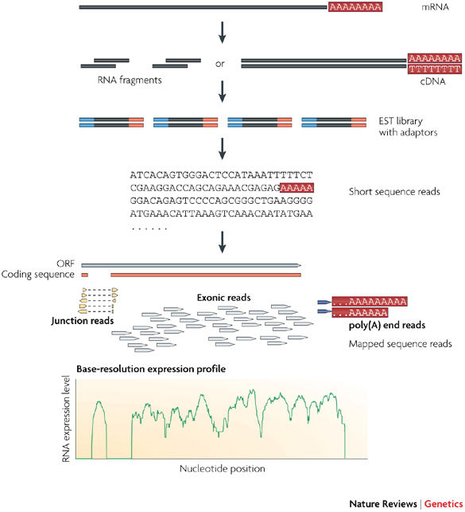
RNAseq
RNAseq focuses on sequencing RNA directly
Identify transcripts and quantify gene expression
Obtain “transcriptome”: snapshot of expression of all genes a time point
Conesa et al., 2016; Wang et al., 2009

Slide 13
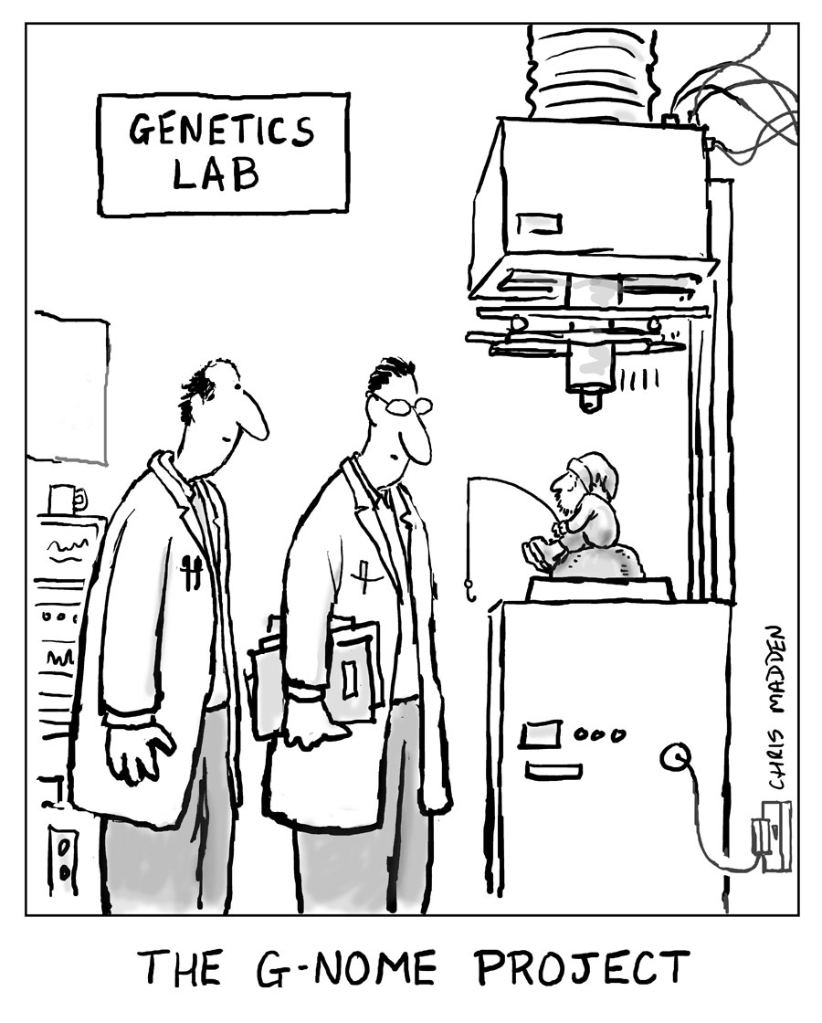
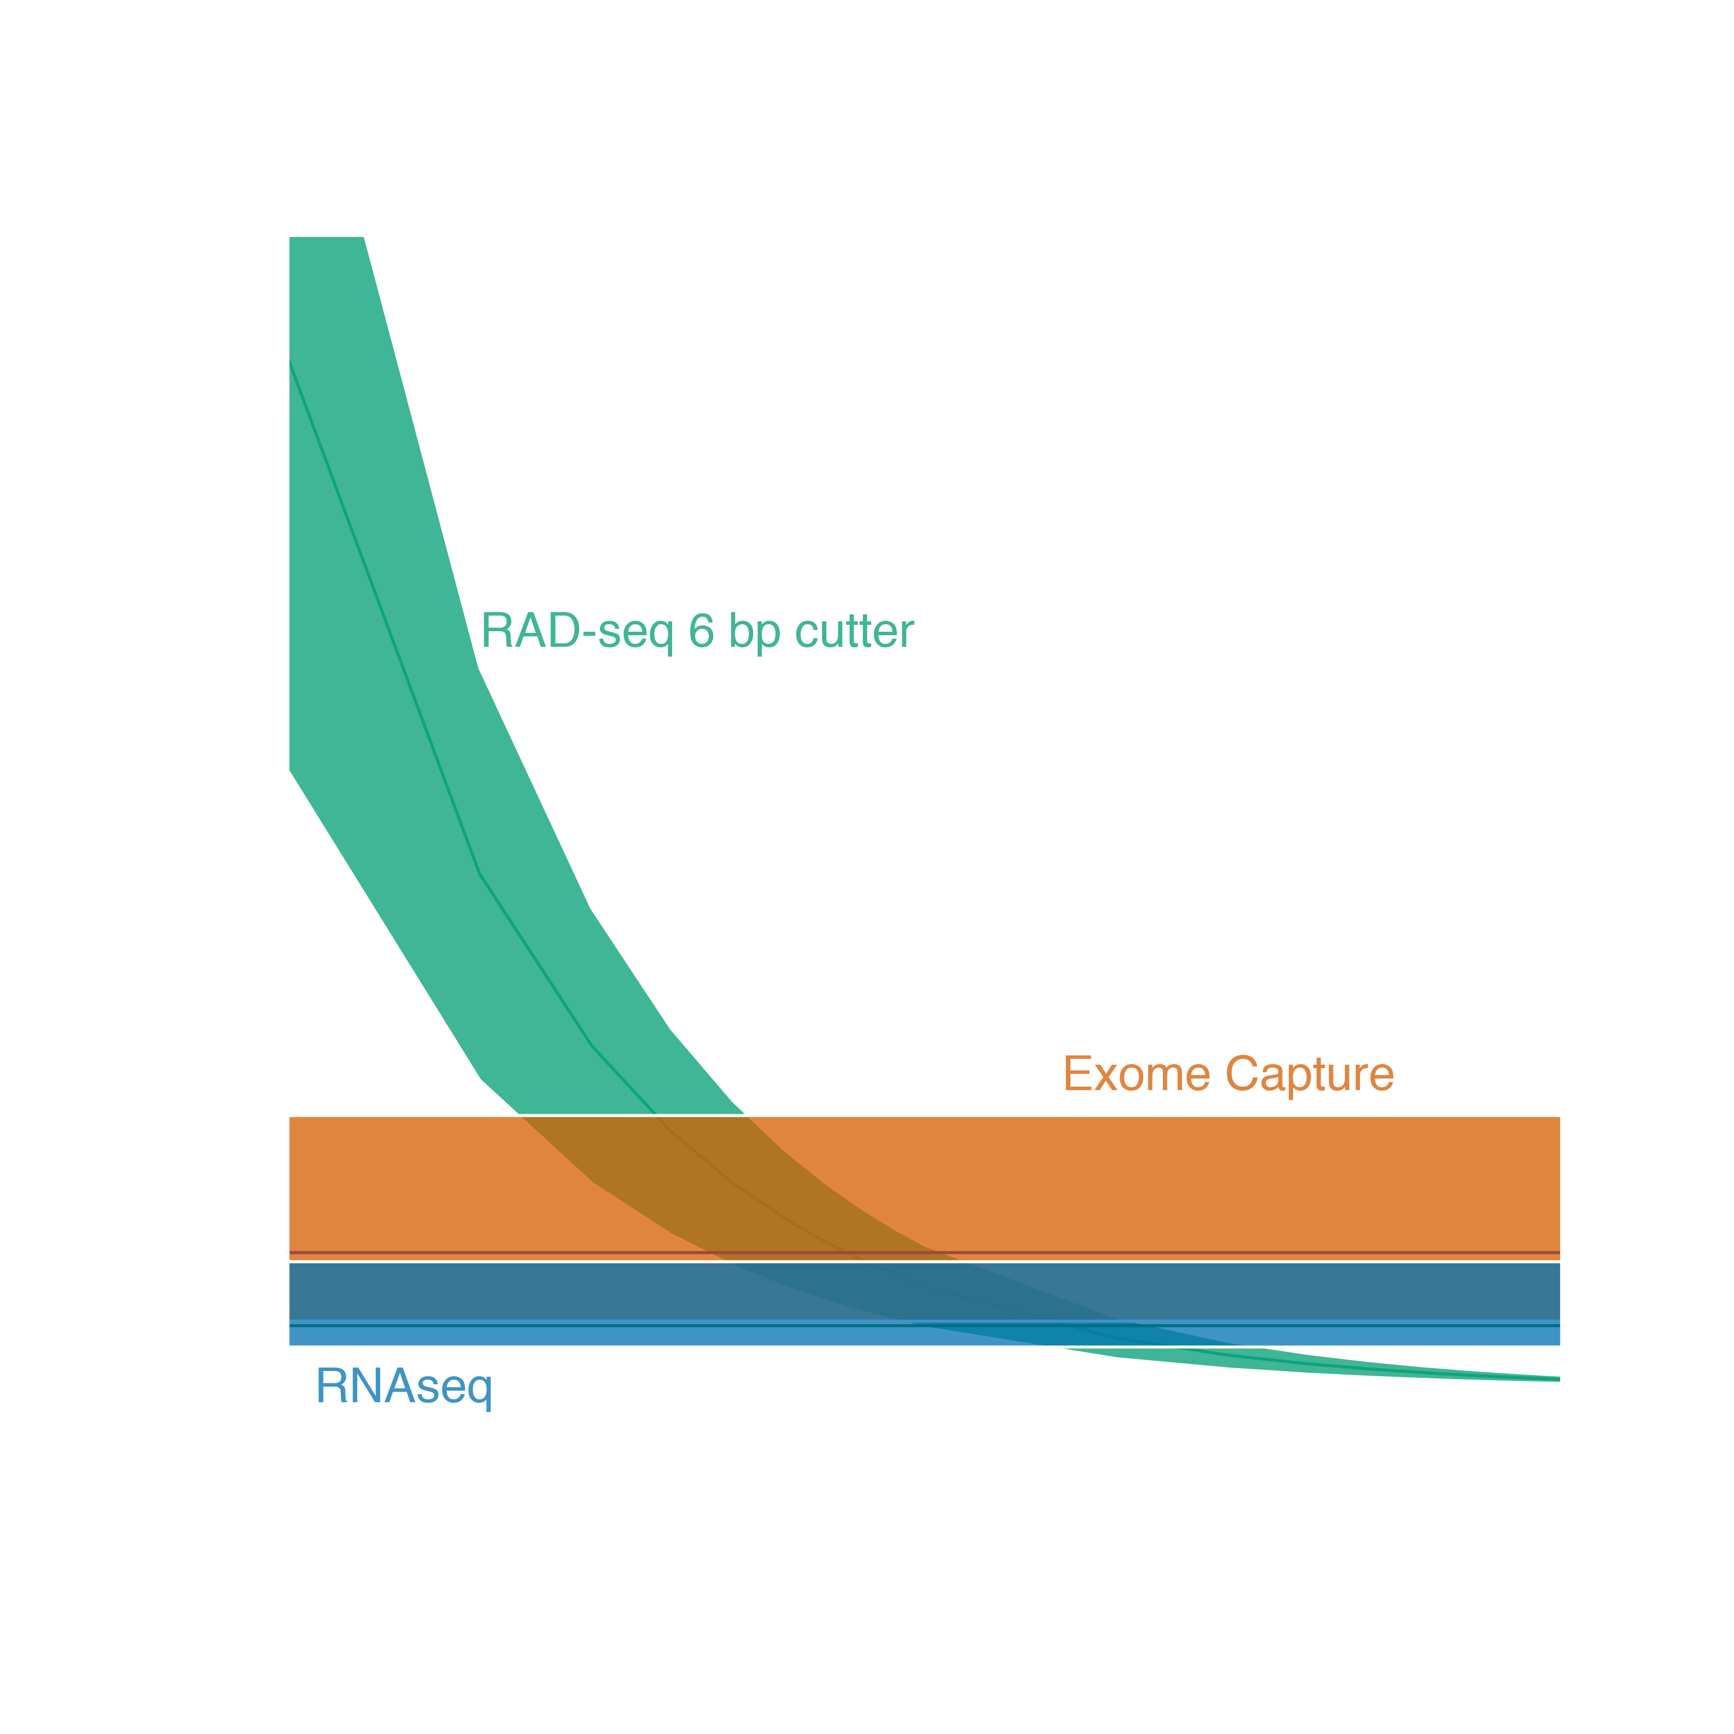
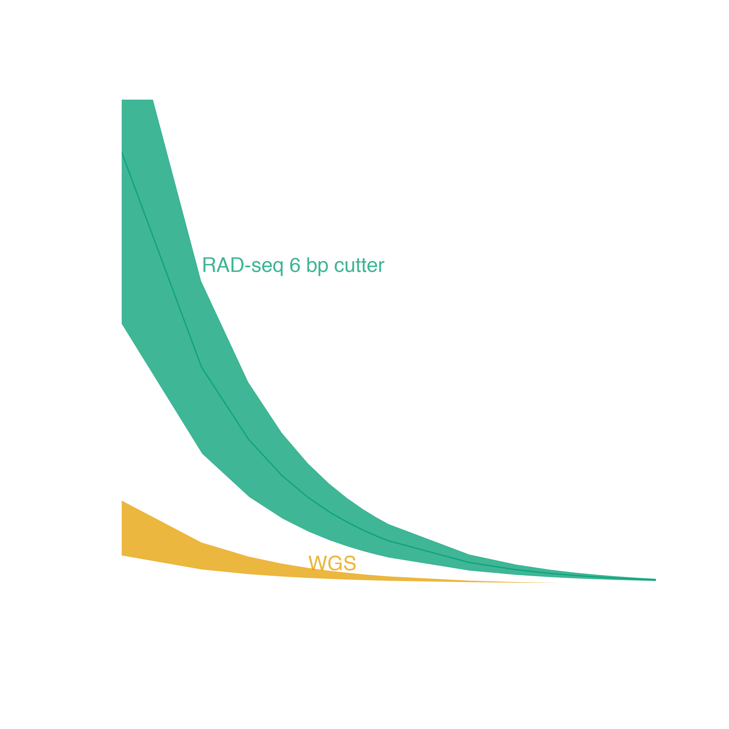
Genome reduction options
With genomic resources
Targeted capture
Ultra Conserved Elements
Exome Capture
Adapted from Lowry et al. 2016

Slide 14
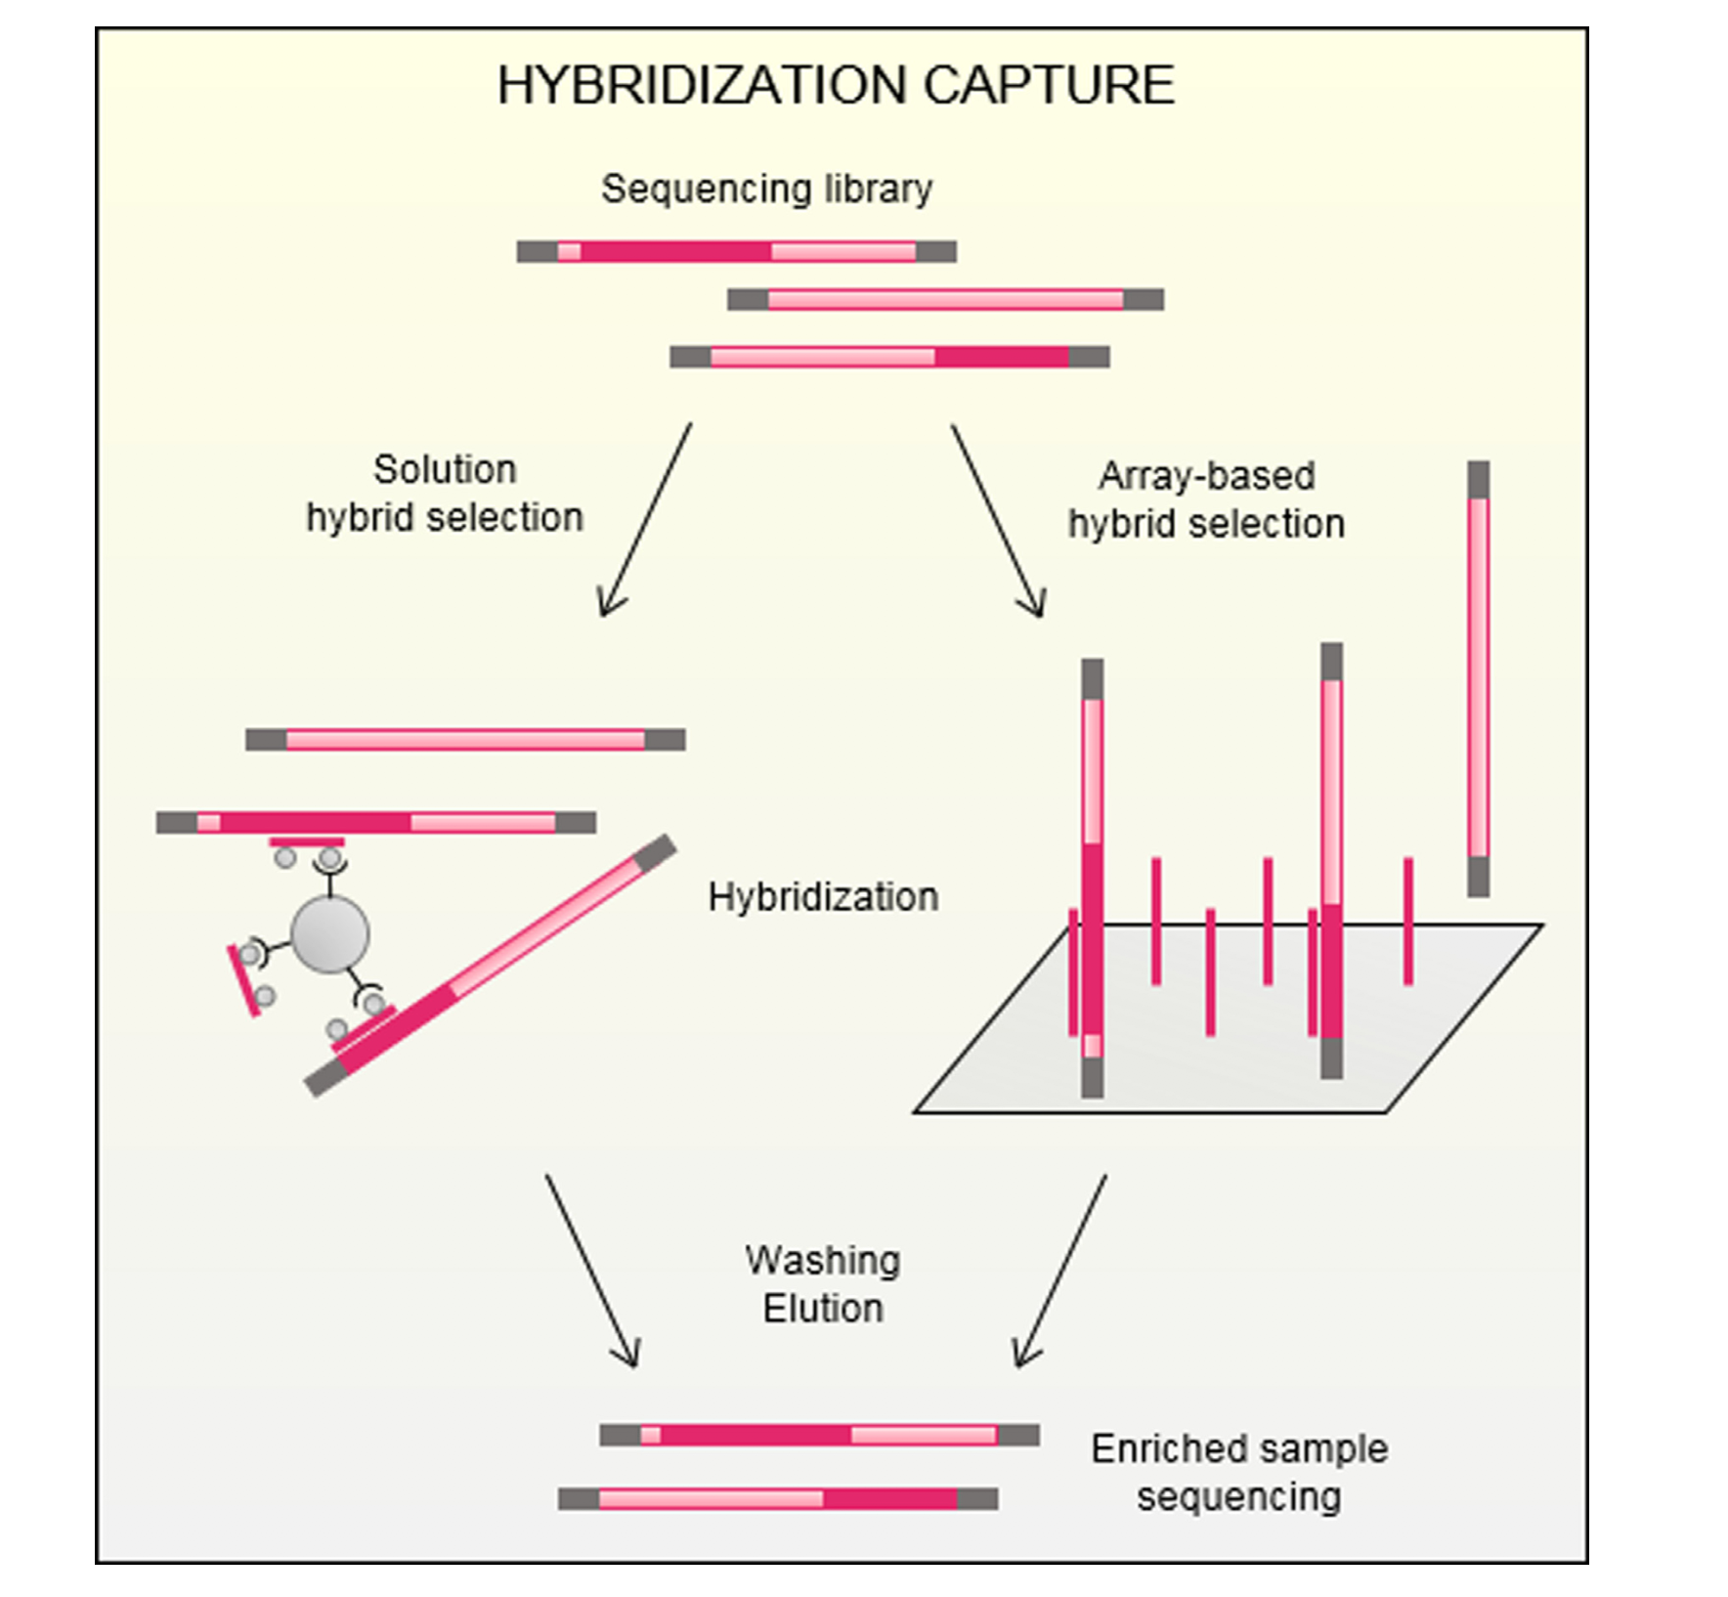
What is targeted capture?
All targeted capture involves first making a shotgun gDNA library
Reduced representation comes from hybridization to targeted probes
Does NOT rely on enzymatic treatment
The number of probes is known and can be fully customized
Gasc et al. 2016
BIO 594

Slide 15
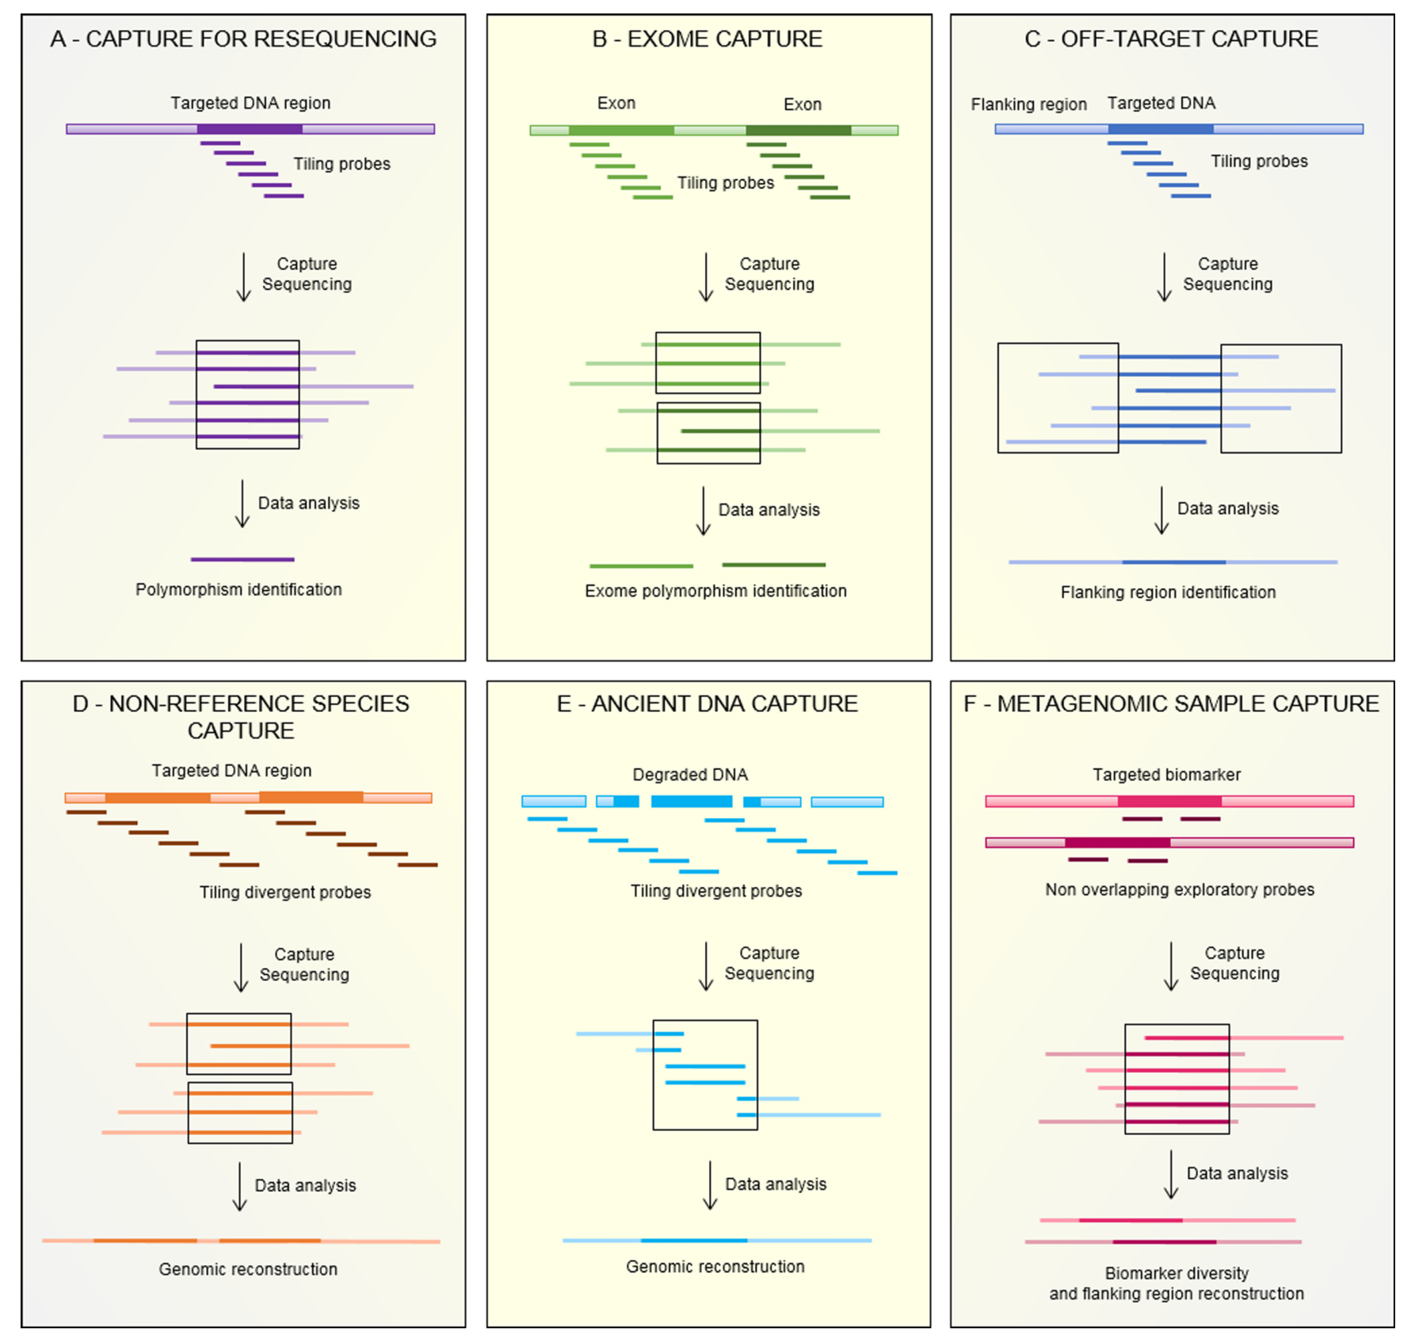
What is targeted capture?
Customization allows for a variety of applications
Dependent on research question
Involves both the number of targets and the number of probes per target
Gasc et al. 2016
BIO 594

Slide 16
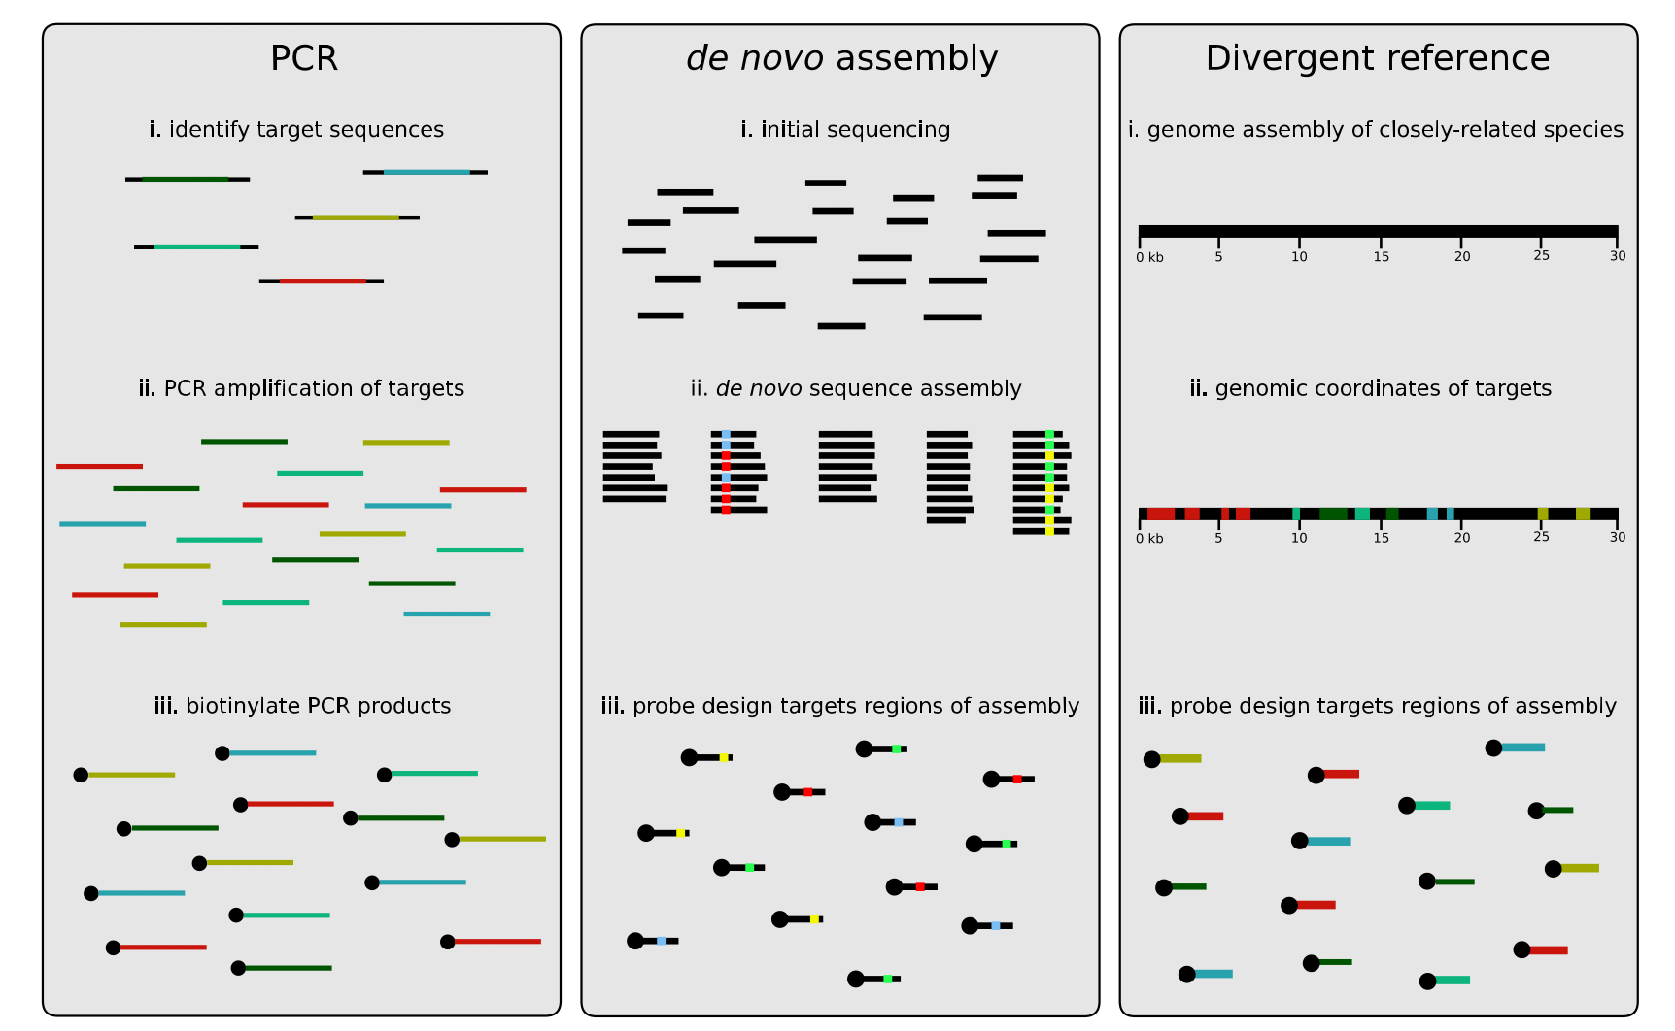
What is targeted capture?
Jones and Good 2016
BIO 594

Slide 17
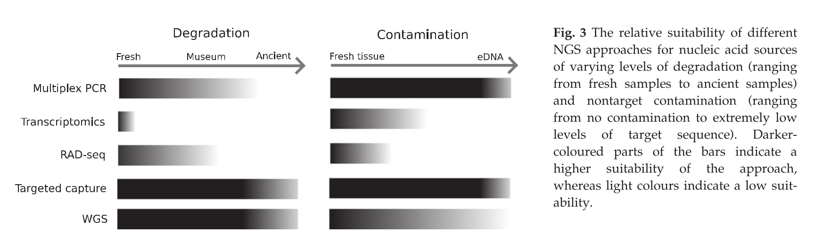
Why use targeted capture?
Jones and Good 2016
BIO 594

Slide 18
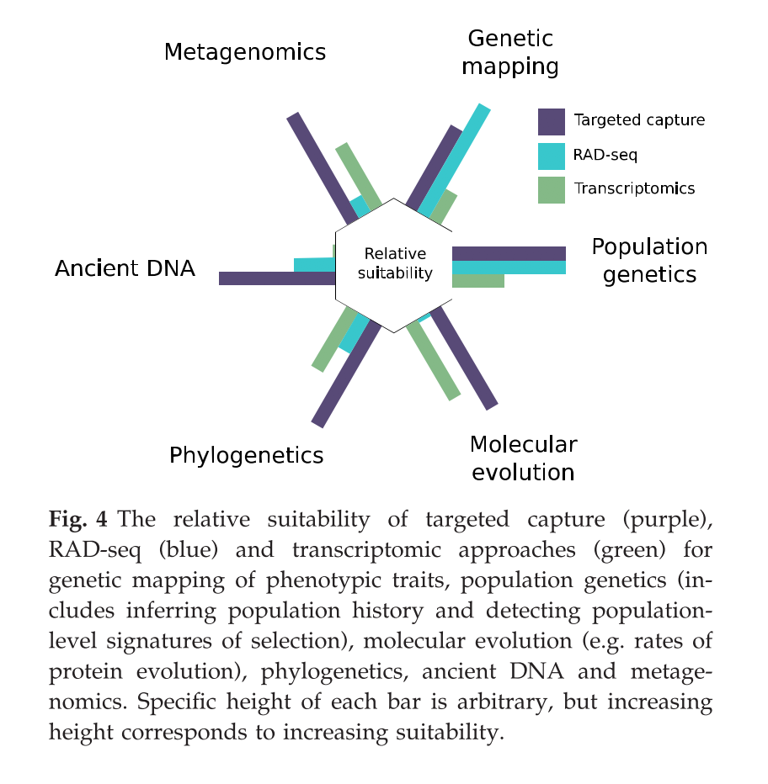
Why use targeted capture?
Jones and Good 2016
BIO 594

Slide 19
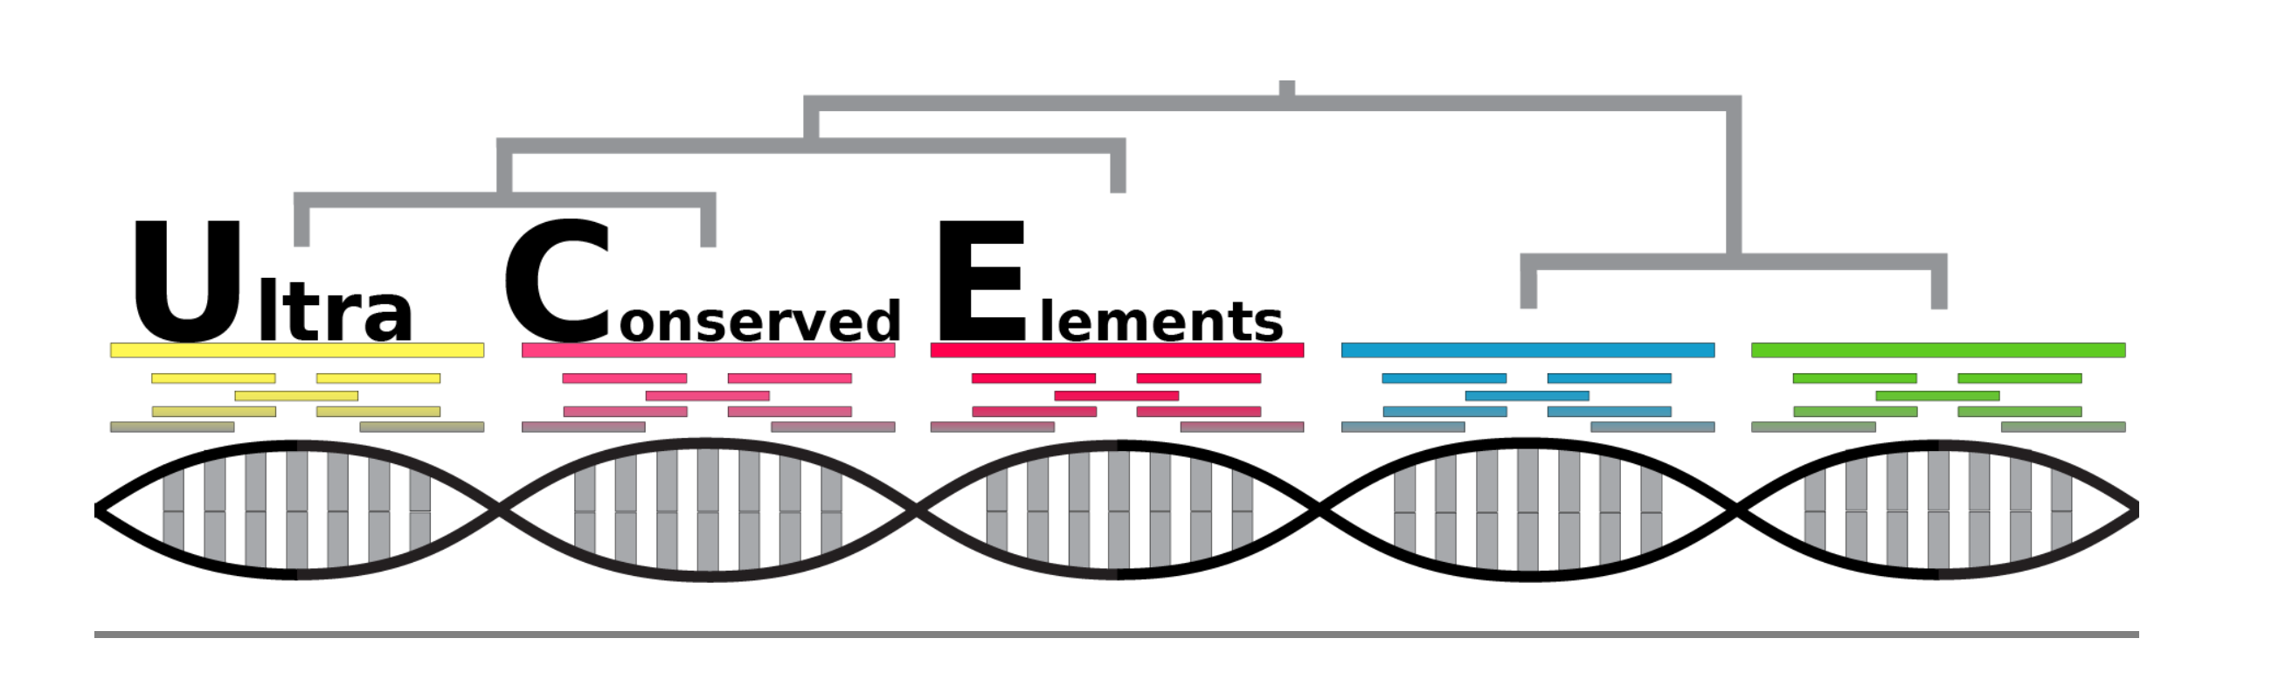
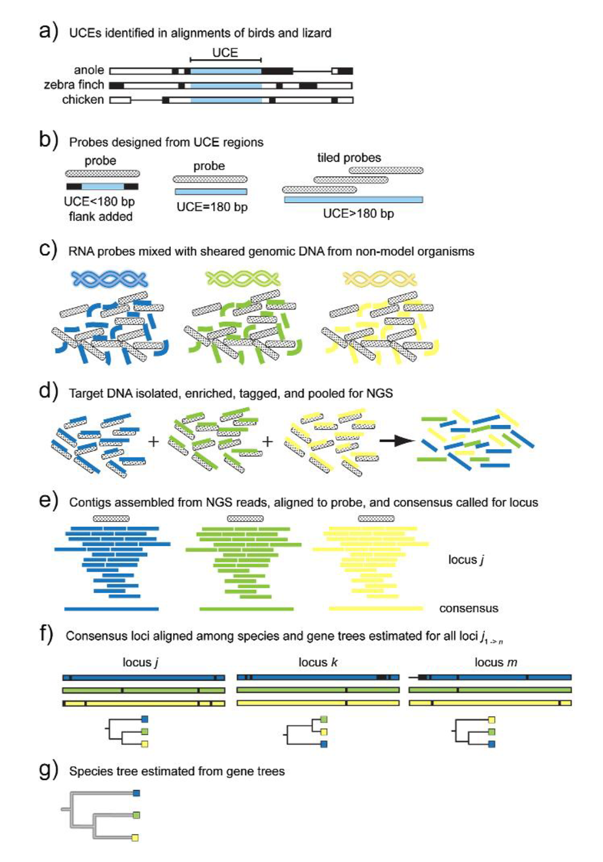
Ultra Conserved Elements
UCEs
highly conserved regions of organismal genomes shared among evolutionary distant taxa
Uses-
data from UCEs and the DNA adjacent to UCE locations (flanking DNA), and that these data are useful for reconstructing the evolutionary history and population-level relationships of many organisms
http://ultraconserved.org
Faircloth et al. 2012
BIO 594

Slide 20
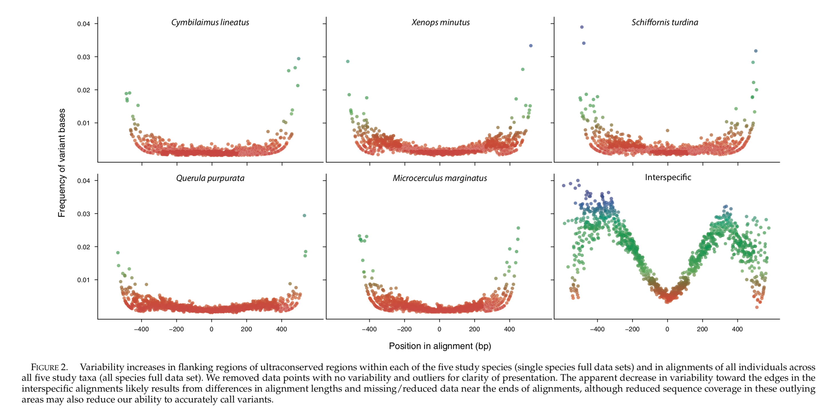
Ultra Conserved Elements
Smith et al. 2014
BIO 594

Slide 21
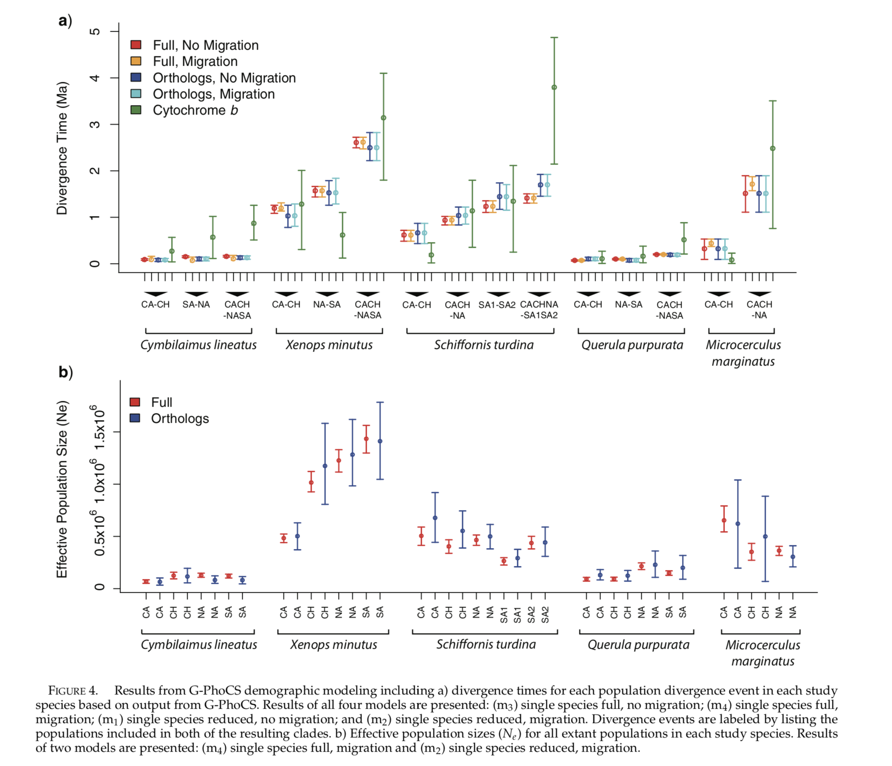
Ultra Conserved Elements
Smith et al. 2014
BIO 594

Slide 22
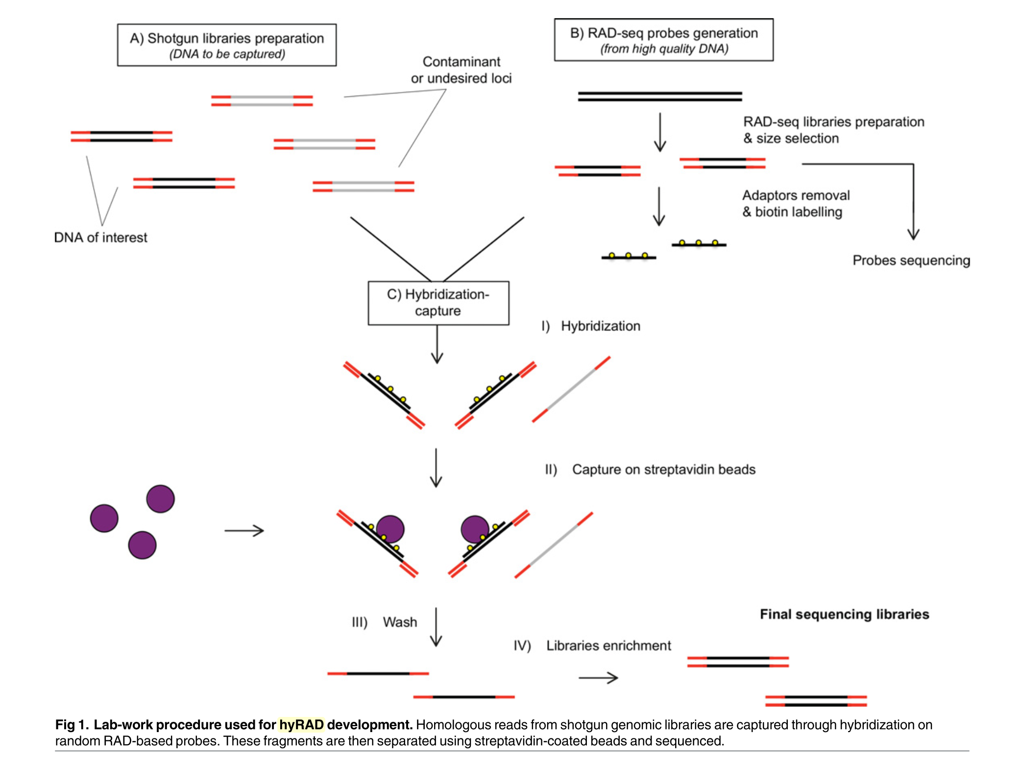
RAD capture, Rapture, hyRAD, hyRAD-X
Suchan et al. 2016
BIO 594

Slide 23
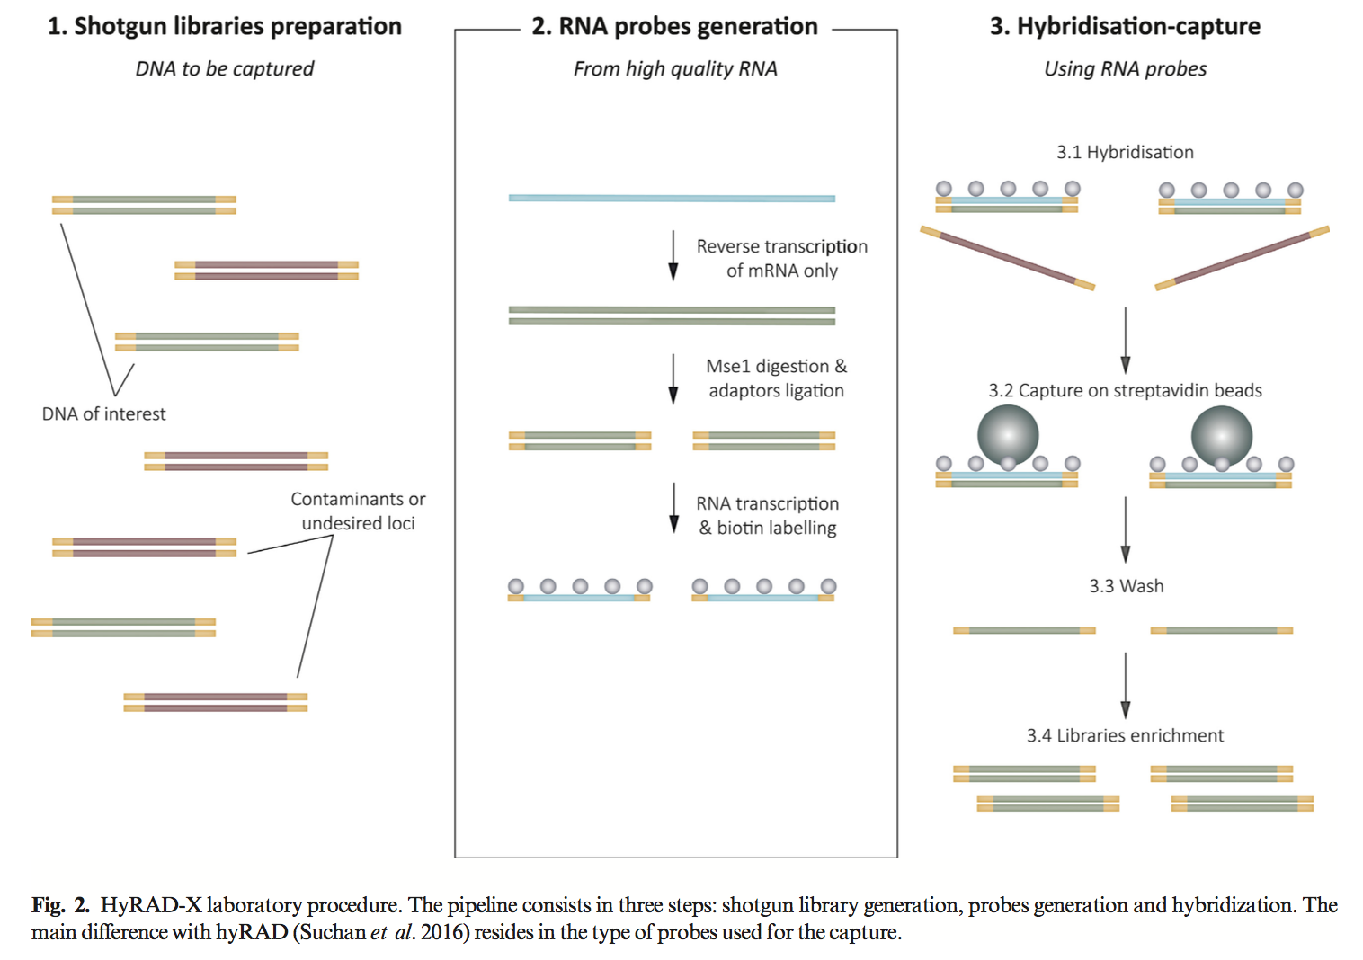
RAD capture, Rapture, hyRAD, hyRAD-X
Schmid et al. 2017
BIO 594

Slide 24
Exome capture
BIO 594

Slide 25
Exome vs genome

Slide 26
Exome vs genome

Slide 27
Exome capture
Exome capture focuses sequencing on the portions of the genome that lead to changes in protein function
BIO 594

Slide 28
The exome: the ultimate genome reduction
RADseq
Cheap
May not sample target genes

Slide 29
The exome: the ultimate genome reduction
RADseq
Cheap
May not sample target genes
RNAseq
Relatively expensive

Slide 30
The exome: the ultimate genome reduction
RADseq
Cheap
May not sample target genes
RNAseq
Relatively expensive

Slide 31
The exome: the ultimate genome reduction
RADseq
Cheap
May not sample target genes
RNAseq
Relatively expensive
Allele specific expression

Slide 32
The exome: the ultimate genome reduction
RADseq
Cheap
May not sample target genes
RNAseq
Relatively expensive
Allele specific expression

Slide 33
The exome: the ultimate genome reduction
RADseq
Cheap
May not sample target genes
RNAseq
Relatively expensive
Allele specific expression
Exome capture
Requires an annotated transcriptome, preferably genome
Requires synthesized probes

Slide 34
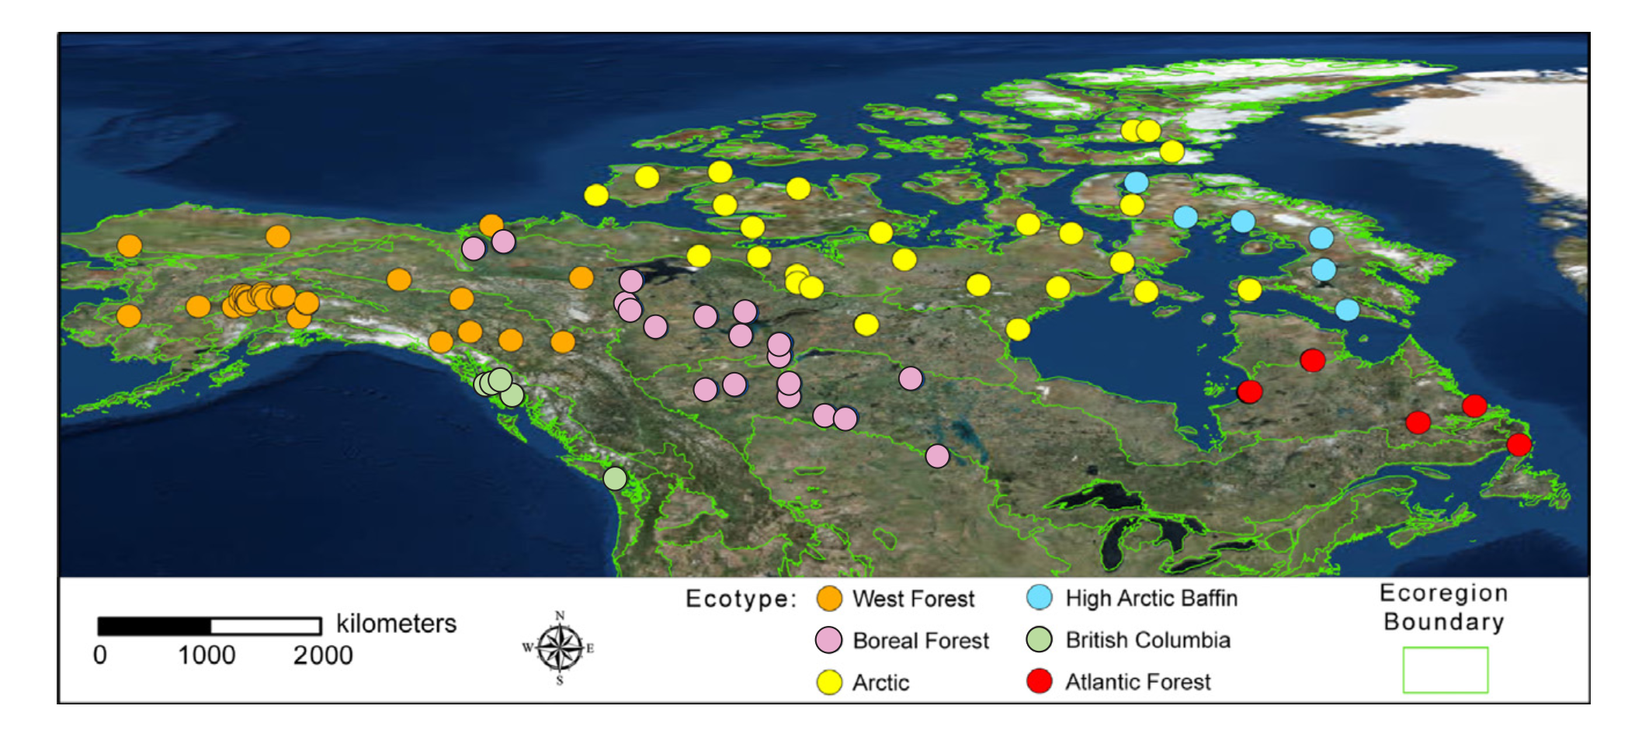
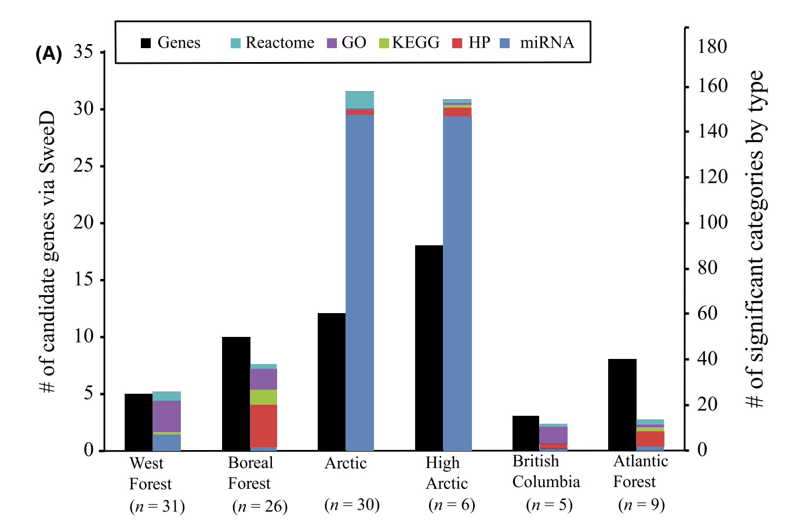
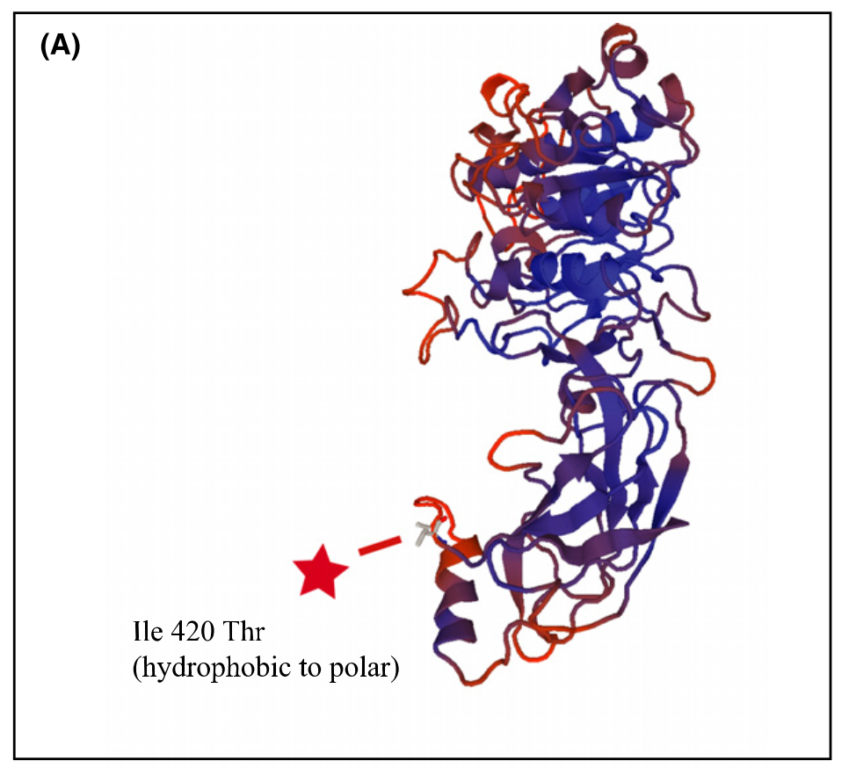
Exome capture
Schweizer et al. 2016
BIO 594

Slide 35
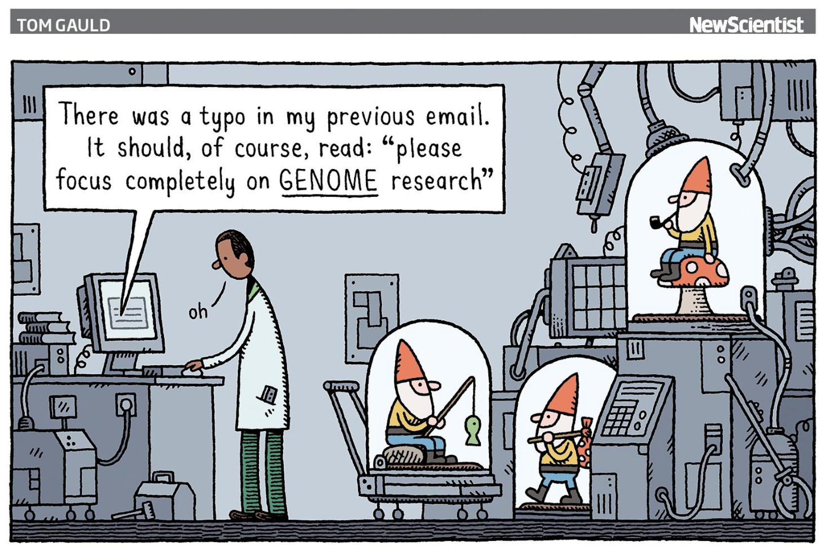
Population genomics without genome reduction
Forget individuals
Estimate allele frequencies from populations directly
PoolSeq
Forget genotypes
Drastically reduce the coverage per individual and work directly with genotype likelihoods
lcWGS
BIO 594

Slide 36
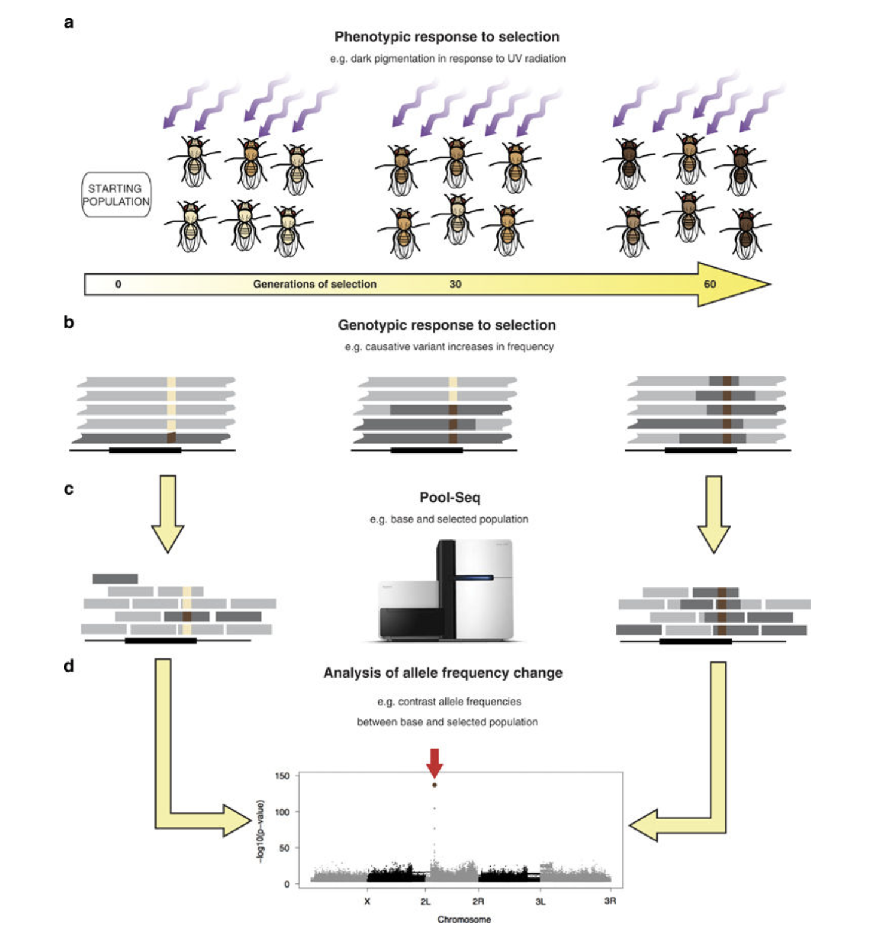
Pooled Sequencing
PoolSeq
DNA/RNA are equimollarly pooled within a population/treatment
Read counts are directly used or placed into a model to estimate the allele frequency of the pool
BIO 594

Slide 37
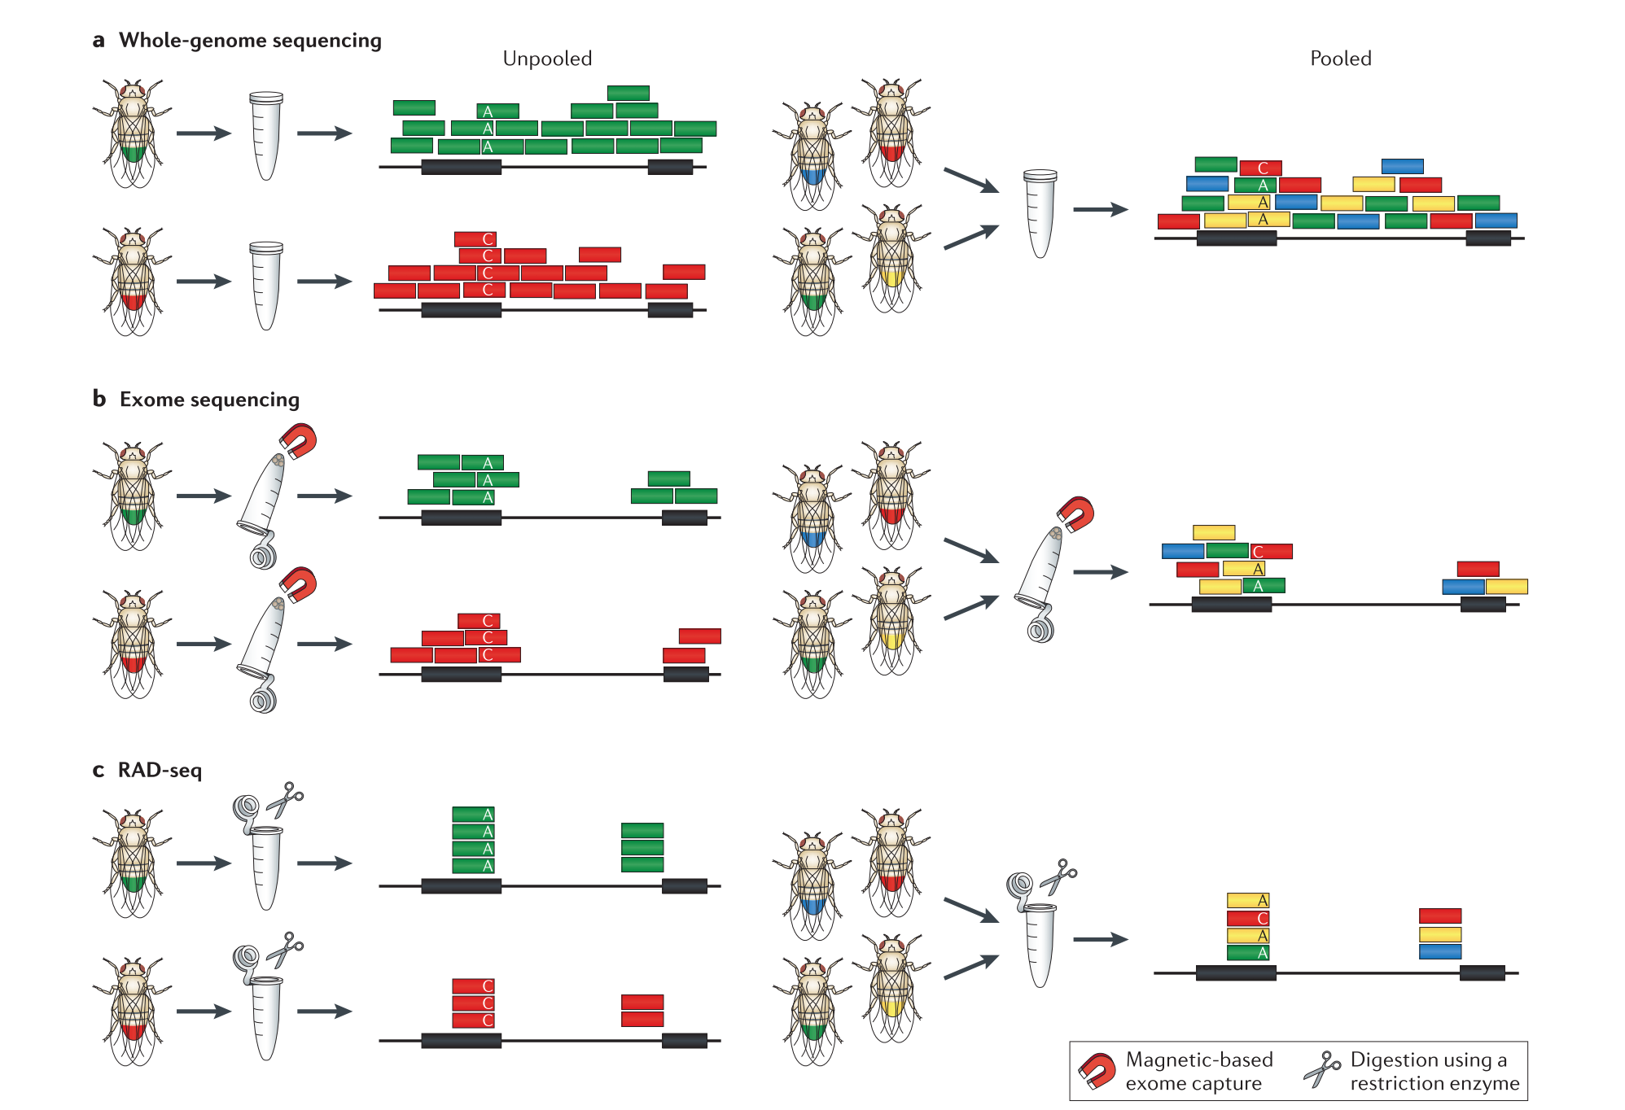
PoolSeq
BIO 594

Slide 38
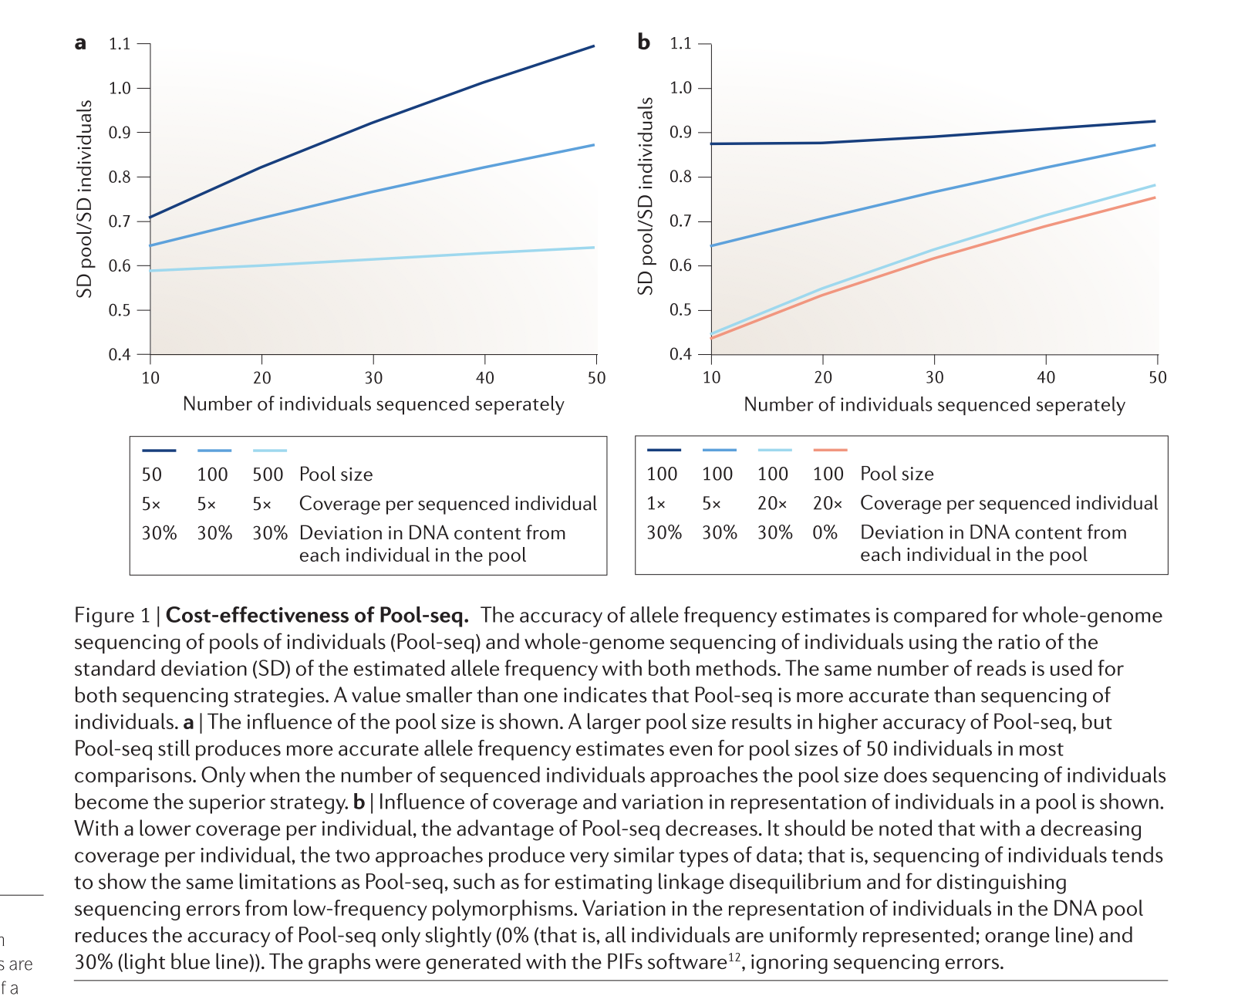
PoolSeq
BIO 594

Slide 39
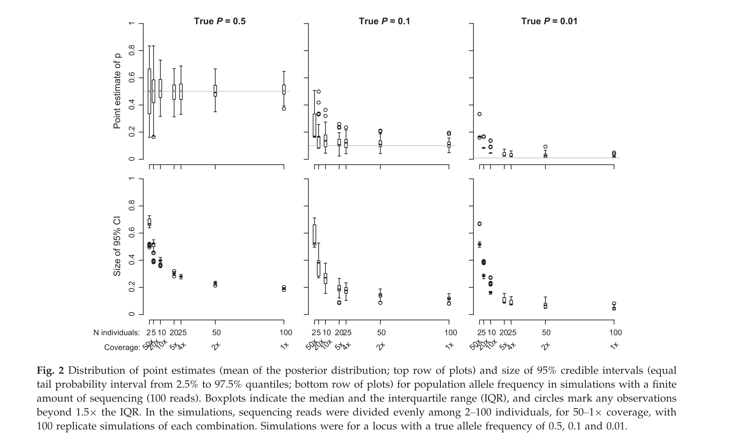
PoolSeq- how low should we go?
BIO 594

Slide 40
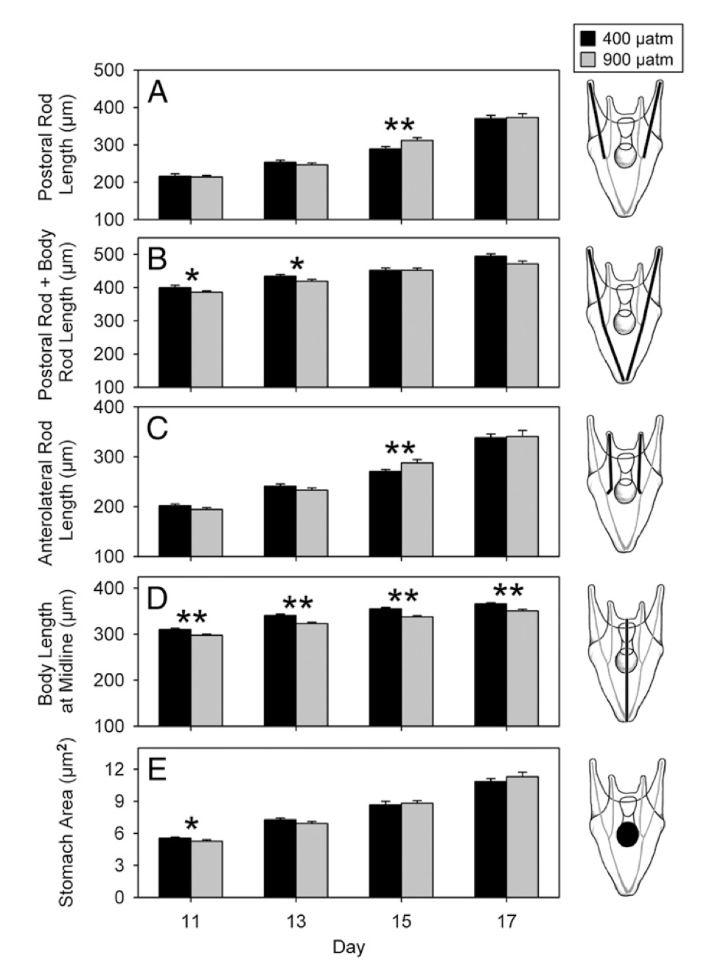
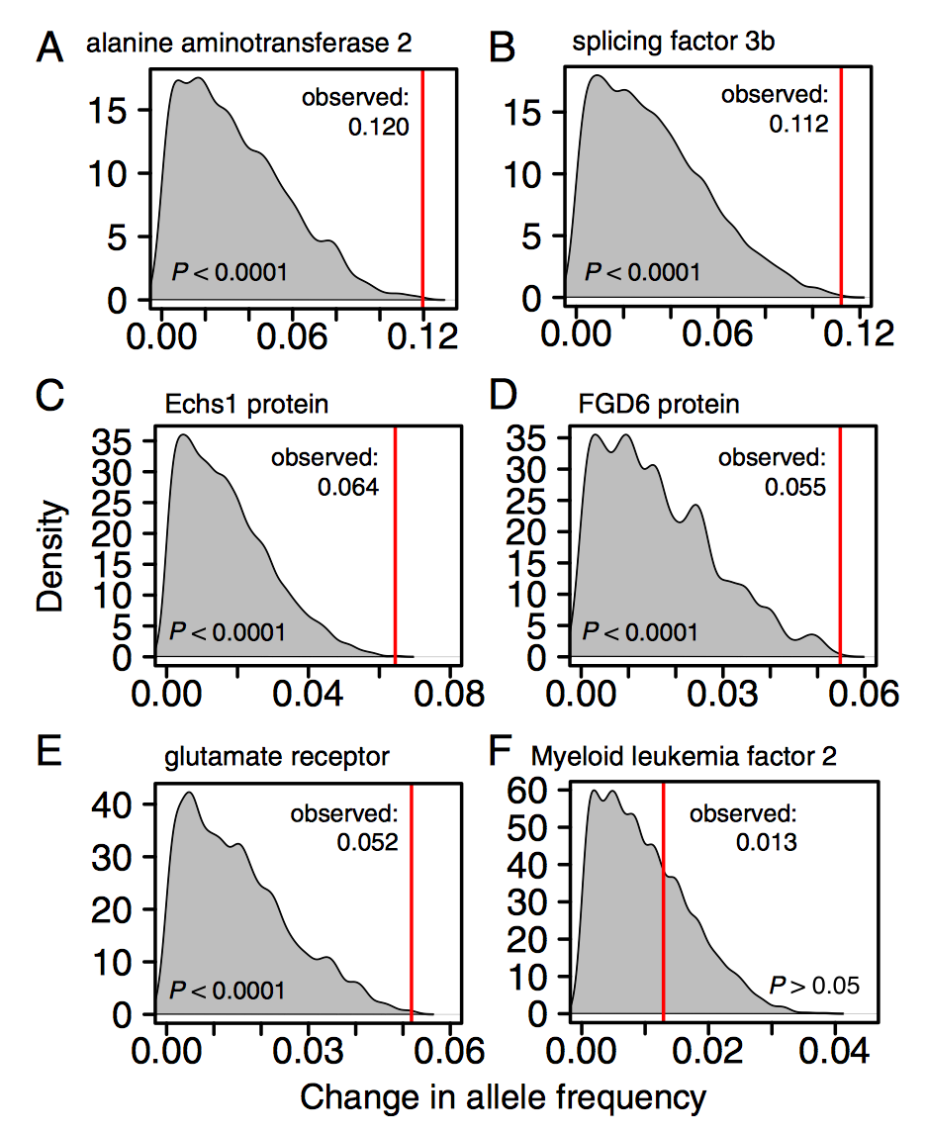
PoolSeq for RNA???????
BIO 594

Slide 41
Low Coverage Whole Genome Sequencing
For this, I am stealing slides from Anders Albrechtsen, one of the authors of ANGSD and expert in this topic
His website can be found: (http://www.popgen.dk/groupWiki/index.php/Anders_Albrechtsen)
BIO 594

Slide 42
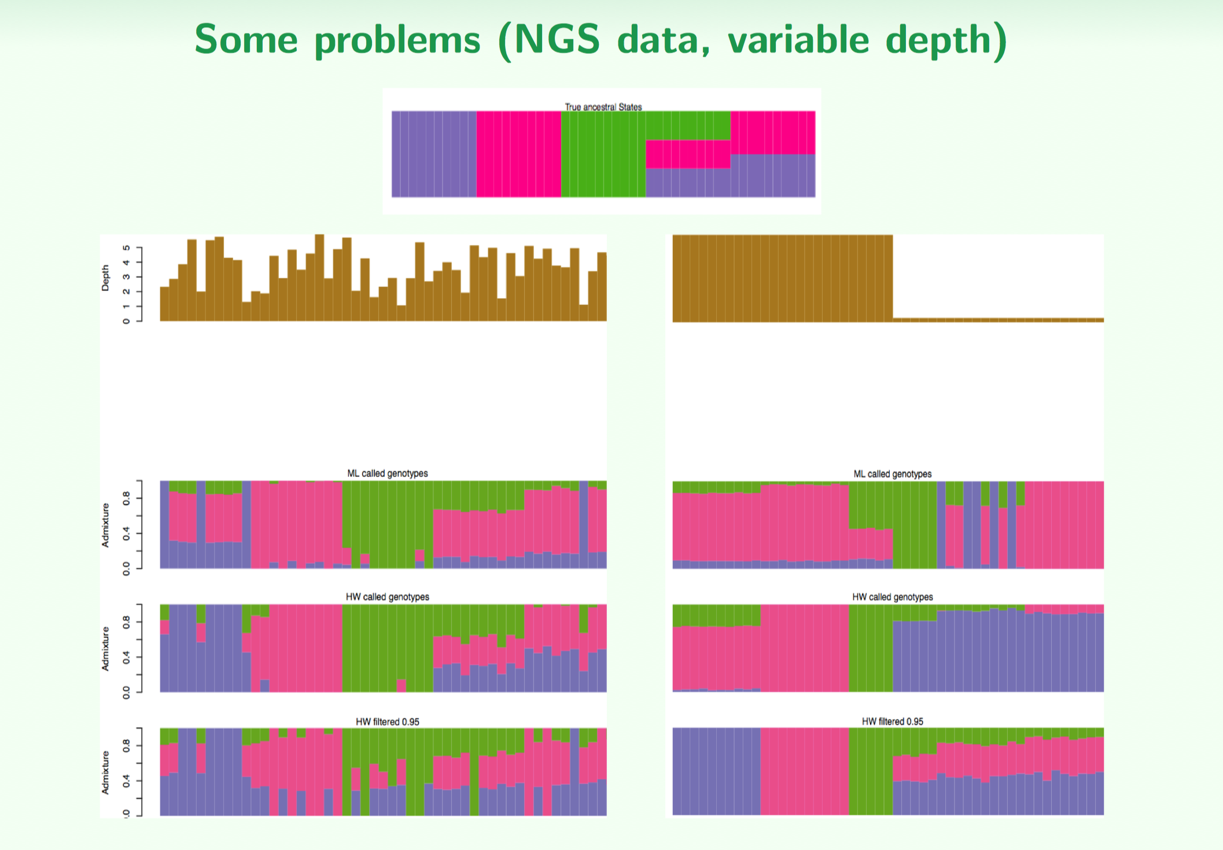
Population genomics with lcWGS
BIO 594

Slide 43
lcWGS: remove genotypes from the equation
AATTCACCTCGGGTATCTTCAGGAAAACGGTCAAAATCAGGTTTCACAGTATATTGGACTCCTC
AATTCACCTCGGGTATCTTCAGGAAAACGGTCAAAATCAGGTTTCACAGTATATTGGACTCCTC
AATTCACCTCGGGTATCTTCAGGAAAACGGTCAAAATCAGGTTTCACAGTATATTGGACTCCTC
AATTCACCTCGGGTATCTTCAGGAAAACGGTCAAAATCAGGTTTCACAGTATATTGGACTCCTC
AATTCACCTCGGGTATCTTCAGGAAAACGGTCAAAATCAGGTTTCACAGTATATTGGACTCCTC
AATTCACCTCGGGTATCTTCAGGAAAACAGTCAAAATCAGGTTTCACAGTATATTGGACTCCTC
AATTCACCTCGGGTATCTTCAGGAAAACAGTCAAAATCAGGTTTCACAGTATATTGGACTCCTC
AATTCACCTCGGGTATCTTCAGGAAAACAGTCAAAATCAGGTTTCACAGTATATTGGACTCCTC
AATTCACCTCGGGTATCTTCAGGAAAACAGTCAAAATCAGGTTTCACAGTATATTGGACTCCTC
AATTCACCTCGGGTATCTTCAGGAAAACAGTCAAAATCAGGTTTCACAGTATATTGGACTCCTC
BIO 594

Slide 44
lcWGS: remove genotypes from the equation
AATTCACCTCGGGTATCTTCAGGAAAACGGTCAAAATCAGGTTTCACAGTATATTGGACTCCTC
AATTCACCTCGGGTATCTTCAGGAAAACGGTCAAAATCAGGTTTCACAGTATATTGGACTCCTC
AATTCACCTCGGGTATCTTCAGGAAAACGGTCAAAATCAGGTTTCACAGTATATTGGACTCCTC
AATTCACCTCGGGTATCTTCAGGAAAACGGTCAAAATCAGGTTTCACAGTATATTGGACTCCTC
AATTCACCTCGGGTATCTTCAGGAAAACGGTCAAAATCAGGTTTCACAGTATATTGGACTCCTC
AATTCACCTCGGGTATCTTCAGGAAAACAGTCAAAATCAGGTTTCACAGTATATTGGACTCCTC
AATTCACCTCGGGTATCTTCAGGAAAACAGTCAAAATCAGGTTTCACAGTATATTGGACTCCTC
AATTCACCTCGGGTATCTTCAGGAAAACAGTCAAAATCAGGTTTCACAGTATATTGGACTCCTC
AATTCACCTCGGGTATCTTCAGGAAAACAGTCAAAATCAGGTTTCACAGTATATTGGACTCCTC
AATTCACCTCGGGTATCTTCAGGAAAACAGTCAAAATCAGGTTTCACAGTATATTGGACTCCTC
Likelihood of this individual being a G/A heterozygote?
Likelihood of this individual being a G/G homozygote?
Likelihood of this individual being a A/A homozygote?
BIO 594

Slide 45
lcWGS: remove genotypes from the equation
AATTCACCTCGGGTATCTTCAGGAAAACGGTCAAAATCAGGTTTCACAGTATATTGGACTCCTC
AATTCACCTCGGGTATCTTCAGGAAAACGGTCAAAATCAGGTTTCACAGTATATTGGACTCCTC
AATTCACCTCGGGTATCTTCAGGAAAACGGTCAAAATCAGGTTTCACAGTATATTGGACTCCTC
AATTCACCTCGGGTATCTTCAGGAAAACGGTCAAAATCAGGTTTCACAGTATATTGGACTCCTC
AATTCACCTCGGGTATCTTCAGGAAAACGGTCAAAATCAGGTTTCACAGTATATTGGACTCCTC
AATTCACCTCGGGTATCTTCAGGAAAACGGTCAAAATCAGGTTTCACAGTATATTGGACTCCTC
AATTCACCTCGGGTATCTTCAGGAAAACGGTCAAAATCAGGTTTCACAGTATATTGGACTCCTC
AATTCACCTCGGGTATCTTCAGGAAAACGGTCAAAATCAGGTTTCACAGTATATTGGACTCCTC
AATTCACCTCGGGTATCTTCAGGAAAACGGTCAAAATCAGGTTTCACAGTATATTGGACTCCTC
AATTCACCTCGGGTATCTTCAGGAAAACGGTCAAAATCAGGTTTCACAGTATATTGGACTCCTC
Likelihood of this individual being a G/A heterozygote?
Likelihood of this individual being a G/G homozygote?
Likelihood of this individual being a A/A homozygote?
BIO 594

Slide 46
lcWGS: remove genotypes from the equation
AATTCACCTCGGGTATCTTCAGGAAAACAGTCAAAATCAGGTTTCACAGTATATTGGACTCCTC
AATTCACCTCGGGTATCTTCAGGAAAACAGTCAAAATCAGGTTTCACAGTATATTGGACTCCTC
AATTCACCTCGGGTATCTTCAGGAAAACAGTCAAAATCAGGTTTCACAGTATATTGGACTCCTC
AATTCACCTCGGGTATCTTCAGGAAAACAGTCAAAATCAGGTTTCACAGTATATTGGACTCCTC
AATTCACCTCGGGTATCTTCAGGAAAACAGTCAAAATCAGGTTTCACAGTATATTGGACTCCTC
AATTCACCTCGGGTATCTTCAGGAAAACAGTCAAAATCAGGTTTCACAGTATATTGGACTCCTC
AATTCACCTCGGGTATCTTCAGGAAAACAGTCAAAATCAGGTTTCACAGTATATTGGACTCCTC
AATTCACCTCGGGTATCTTCAGGAAAACAGTCAAAATCAGGTTTCACAGTATATTGGACTCCTC
AATTCACCTCGGGTATCTTCAGGAAAACAGTCAAAATCAGGTTTCACAGTATATTGGACTCCTC
AATTCACCTCGGGTATCTTCAGGAAAACAGTCAAAATCAGGTTTCACAGTATATTGGACTCCTC
Likelihood of this individual being a G/A heterozygote?
Likelihood of this individual being a G/G homozygote?
Likelihood of this individual being a A/A homozygote?
BIO 594

Slide 47
lcWGS: remove genotypes from the equation
AATTCACCTCGGGTATCTTCAGGAAAACGGTCAAAATCAGGTTTCACAGTATATTGGACTCCTC
AATTCACCTCGGGTATCTTCAGGAAAACGGTCAAAATCAGGTTTCACAGTATATTGGACTCCTC
AATTCACCTCGGGTATCTTCAGGAAAACGGTCAAAATCAGGTTTCACAGTATATTGGACTCCTC
AATTCACCTCGGGTATCTTCAGGAAAACGGTCAAAATCAGGTTTCACAGTATATTGGACTCCTC
AATTCACCTCGGGTATCTTCAGGAAAACGGTCAAAATCAGGTTTCACAGTATATTGGACTCCTC
AATTCACCTCGGGTATCTTCAGGAAAACGGTCAAAATCAGGTTTCACAGTATATTGGACTCCTC
AATTCACCTCGGGTATCTTCAGGAAAACGGTCAAAATCAGGTTTCACAGTATATTGGACTCCTC
AATTCACCTCGGGTATCTTCAGGAAAACGGTCAAAATCAGGTTTCACAGTATATTGGACTCCTC
AATTCACCTCGGGTATCTTCAGGAAAACAGTCAAAATCAGGTTTCACAGTATATTGGACTCCTC
AATTCACCTCGGGTATCTTCAGGAAAACAGTCAAAATCAGGTTTCACAGTATATTGGACTCCTC
Likelihood of this individual being a G/A heterozygote?
Likelihood of this individual being a G/G homozygote?
Likelihood of this individual being a A/A homozygote?
BIO 594

Slide 48
lcWGS: remove genotypes from the equation
AATTCACCTCGGGTATCTTCAGGAAAACGGTCAAAATCAGGTTTCACAGTATATTGGACTCCTC
AATTCACCTCGGGTATCTTCAGGAAAACGGTCAAAATCAGGTTTCACAGTATATTGGACTCCTC
AATTCACCTCGGGTATCTTCAGGAAAACGGTCAAAATCAGGTTTCACAGTATATTGGACTCCTC
AATTCACCTCGGGTATCTTCAGGAAAACAGTCAAAATCAGGTTTCACAGTATATTGGACTCCTC
AATTCACCTCGGGTATCTTCAGGAAAACAGTCAAAATCAGGTTTCACAGTATATTGGACTCCTC
Likelihood of this individual being a G/A heterozygote?
Likelihood of this individual being a G/G homozygote?
Likelihood of this individual being a A/A homozygote?
BIO 594

Slide 49
lcWGS: remove genotypes from the equation
AATTCACCTCGGGTATCTTCAGGAAAACGGTCAAAATCAGGTTTCACAGTATATTGGACTCCTC
AATTCACCTCGGGTATCTTCAGGAAAACAGTCAAAATCAGGTTTCACAGTATATTGGACTCCTC
Likelihood of this individual being a G/A heterozygote?
Likelihood of this individual being a G/G homozygote?
Likelihood of this individual being a A/A homozygote?
BIO 594

Slide 50
lcWGS: remove genotypes from the equation
Likelihood of this individual being a G/A heterozygote L1
Likelihood of this individual being a G/G homozygote L2
Likelihood of this individual being a A/A homozygote L3
BIO 594

Slide 51
lcWGS: remove genotypes from the equation
Likelihood of this individual being a G/A heterozygote L1
Likelihood of this individual being a G/G homozygote L2
Likelihood of this individual being a A/A homozygote L3
Individual | G/A | G/G | A/A | F(A) | F(G)
IND_01 | L1_01 | L2_01 | L3_01
IND_02 | L1_02 | L2_02 | L3_02
IND_03 | L1_03 | L2_03 | L3_03
IND_04 | L1_04 | L2_04 | L3_04
IND_05 | L1_05 | L2_05 | L3_05
BIO 594

Slide 52
lcWGS: remove genotypes from the equation
Likelihood of this individual being a G/A heterozygote L1
Likelihood of this individual being a G/G homozygote L2
Likelihood of this individual being a A/A homozygote L3
Individual | G/A | G/G | A/A | F(A) | F(G)
IND_01 | L1_01 | L2_01 | L3_01
IND_02 | L1_02 | L2_02 | L3_02
IND_03 | L1_03 | L2_03 | L3_03
IND_04 | L1_04 | L2_04 | L3_04
IND_05 | L1_05 | L2_05 | L3_05
Genotypes likelihoods can the be imputed again from population level allele frequencies
However, this relies on the assumption of HWE!!!!
BIO 594

